Slide 1
Midterm Overview
Basic Information

Slide 2
Exam Date and Time
Date: Wednesday, March 16th
Time: 4-5:10 pm
Place: 138 Class Room

Slide 3
Exam Specifications
1 hr 10min long
Closed book/notes
Multiple choice
Guess
×

Slide 4
What You Need To Bring to Exam 1
NCS Form 4521
big, blue / purple
available in the Hornet Bookstore and Union Store
Number 2 Pencil Only
Very Good ERASER

Slide 5
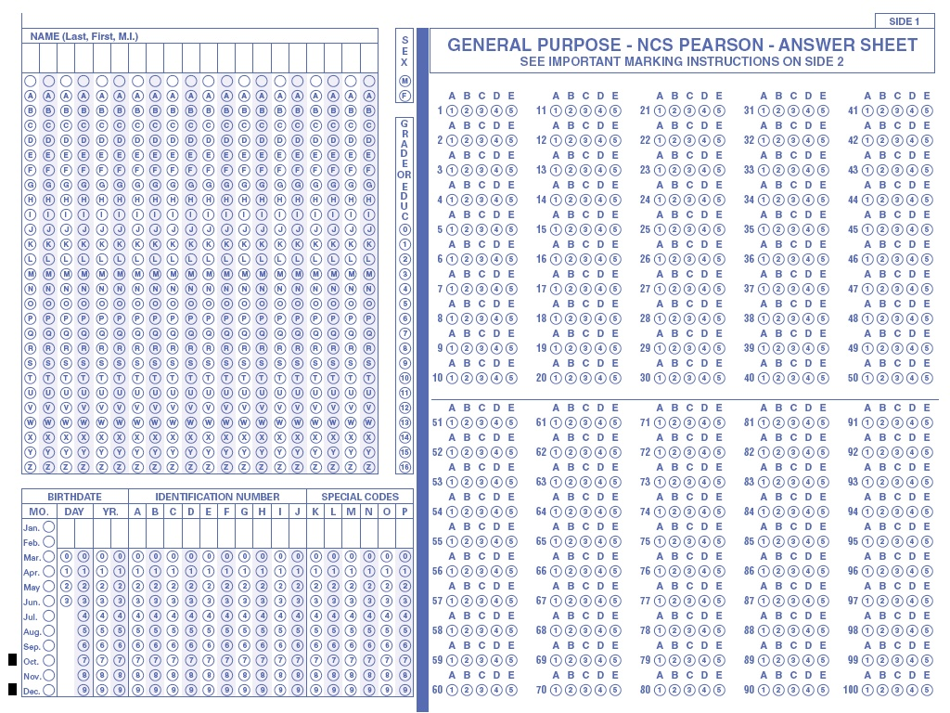
NCS Pearson 4521

Slide 6
What You Need for the Exam - Reference Sheet
One 8 ½" x 11"
Two Sides
Hand-written or Typed!
No photocopies
You will leave it with the exam

Slide 7
Midterm1 Review
Midterm1 Study Guide

Slide 8
Chapter 1 Intro to Networks: Important to Know
Layers of Internet, OSI, and functions of the layers
Network Edge, Core, Layers and Services
Protocols and Service Models
Packet and Circuit Switching
Throughput, Delay parameters.
Intro to Internet Security

Slide 9
Chapter 1 Intro to Networks : Don't Worry About
Specific Frequencies of Media
Specific upstream and downstream data rates of edge networks
Loss calculations

Slide 10
Chapter 2 – Application Layer: Important to Know
Principles of Network Applications: Client/Server, P2P models, process communication, transport services (TCP/UDP)
Web and HTTP including persistent/non-persistent
FTP and SMTP, POP, IMAP
DNS: Model, design concepts, RR, Examples
DNS Security

Slide 11
Chapter 2 – Application Layer: Important to Know
DNS Design Concepts: Geographic Distribution, Caching, Replication, Hierarchy, etc.
DNS RR major types and how they are used
Content of DNS Message Format
Client/Server Programming concepts

Slide 12
Chapter 2 – Application Layer: Don't Worry About
Detailed Packet formats of various application protocols, etc... BUT YOU SHOULD KNOW THE FIELDS

Slide 13
Chapter 2 – Application Layer: Don't Worry About
Detailed commands issued during protocol exchanges.

Slide 14
Chapter 3 – Transport Layer: Important to Know
Transport Services and Functions
Multiplexing and Demultiplexing
How is this implemented?
Reliable and Unreliable communication
Use of checksum, sequence numbers, timers and why?
Explanation using state machine and especially handshake diagrams

Slide 15
Chapter 3 – Transport Layer 2: Important to Know
Reliable Data Transfer:
Stop and Wait (SW), Go-Back-N (GBN), Selective Repeat/Reject/Retransmission (SR) protocols.
Note the differences between these protocols including buffer requirements at sender and receiver and how they are implemented in TCP.
Sequence Number assignments and how they affect maximum window size.

Slide 16
Chapter 3 – Transport Layer 3: Important to Know
In TCP which fields are used to implement following and how?:
Sequence Numbers: Purpose and how they are used
Error Control: Checksum, what is checked by Checksum, protocols (Go-Back-N,) … , etc,
Flow control (sliding window):
Window Advertisement,

Slide 17
Chapter 3 – Transport Layer 4: Important to Know
TCP which fields are used to implement following and how:
Connection management: Handshake protocols,
Congestion Control: Principles, AIMD, Slow Start, TCP Tahoe, TCP Reno, etc.
UDP. Difference with TCP.
When to use TCP or UDP and why.
TCP Timers. Dynamic timer calculation

Slide 18
Chapter 3 – Transport Layer 5: Don't Worry About
Detailed packet format for transport protocols but should know the fields and functions
Timer calculation detailed formulas involving standard deviation but must understand components of the basic dynamic timer formula

Slide 19
Chapter 4– Network Layer 1: Important to Know
Forwarding and Routing
Network Service Models: Best Effort and Guaranteed Delivery.
Datagrams vs Virtual Circuits

Slide 20
Chapter 4– Network Layer 2: Important to Know
Router Internals: Input, Switch Fabric, Output
Internet Protocol (IPv4): Header Information, the purpose of the various fields and units of measure as applicable.
Addressing, forwarding, hierarchy
Fragmentation and Reassembly and calculations
Error checking
Options fields mentioned (eg source routing, record route, etc)

Slide 21
How To Study for the Midterm Exam
Go through homework problems
Go through lecture notes (slides on SacCT plus clarifying comments from class).
Go through study questions assigned
Prepare for the exam as if it is a closed book and closed notes exam even though you are allowed sheet of notes

Slide 22
Good Luck on the Exam!

